Slide 1

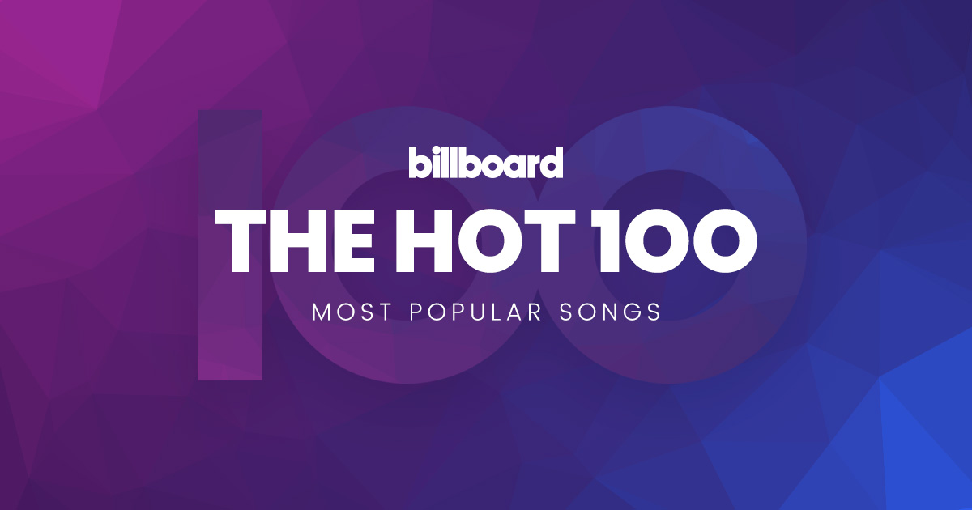

Analysis on the Billboard Chart
: Understanding the Popular Music

Slide 2

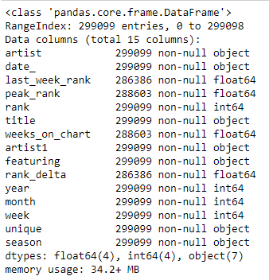
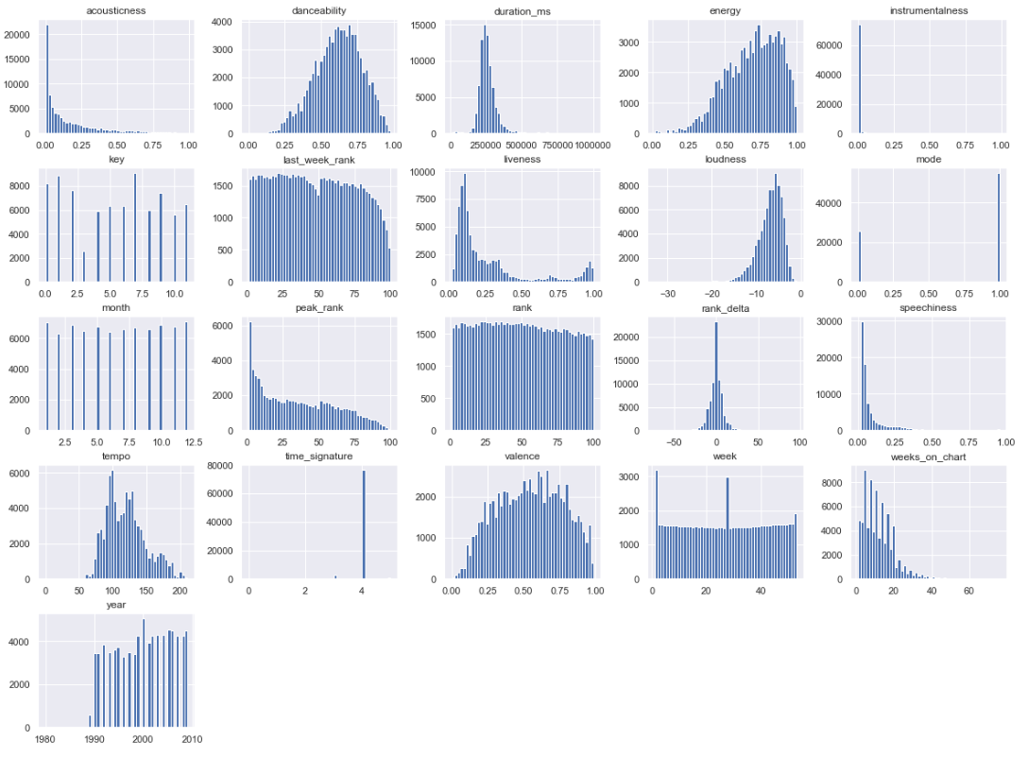
Billboard Hot 100:
The music industry standard record chart in the United States
Chart rankings are based on:
Sales (physical & digital)
Radio play
Online streaming
in United States
~ 300,000 tracks cumulated since August 16th of 1958
~ 28,000 unique tracks removing the duplicates
Notes:
Obtain features such as:
-1W Rank
CW Rank
Peak Rank
Date
(Season, Month, Year, WoW Delta etc. )

Slide 3



Simple Check:
Does Billboard look into data before choosing the Billboard's Top Artist Winner?
:Ed Sheeran
Notes:
Unlike other awards, such as the Grammy Award, the Billboard Music Awards finalists are based on album and digital by Nielson.
The 2018 awards are based on the reporting period of April 8, 2017 through March 31, 2018.
songs sales, streaming, radio airplay, touring, and social engagement data provided

Slide 4
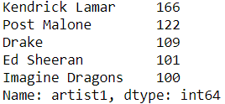
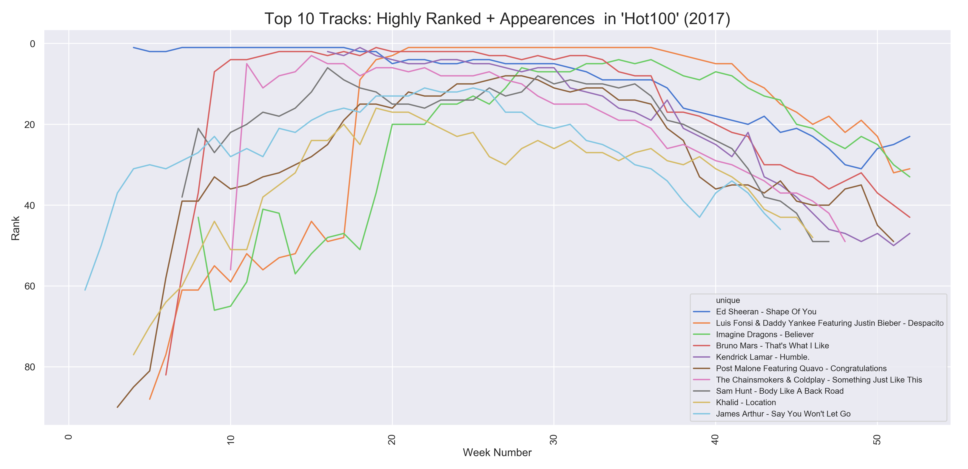
Simply By Most Appearance…..

Slide 5
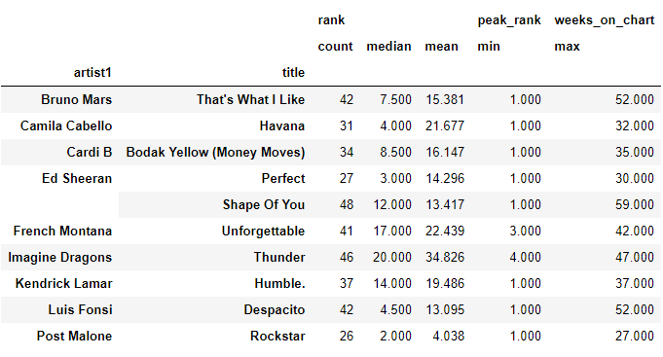
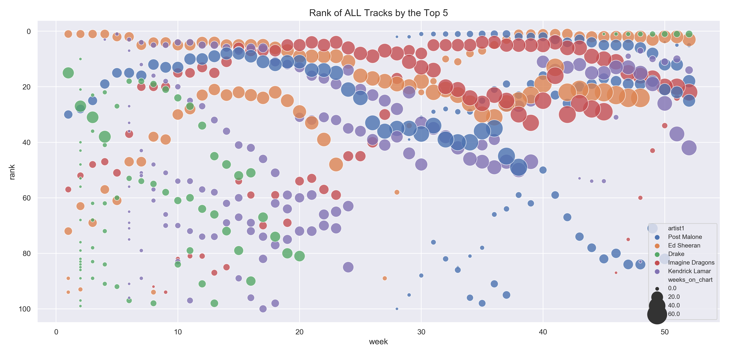
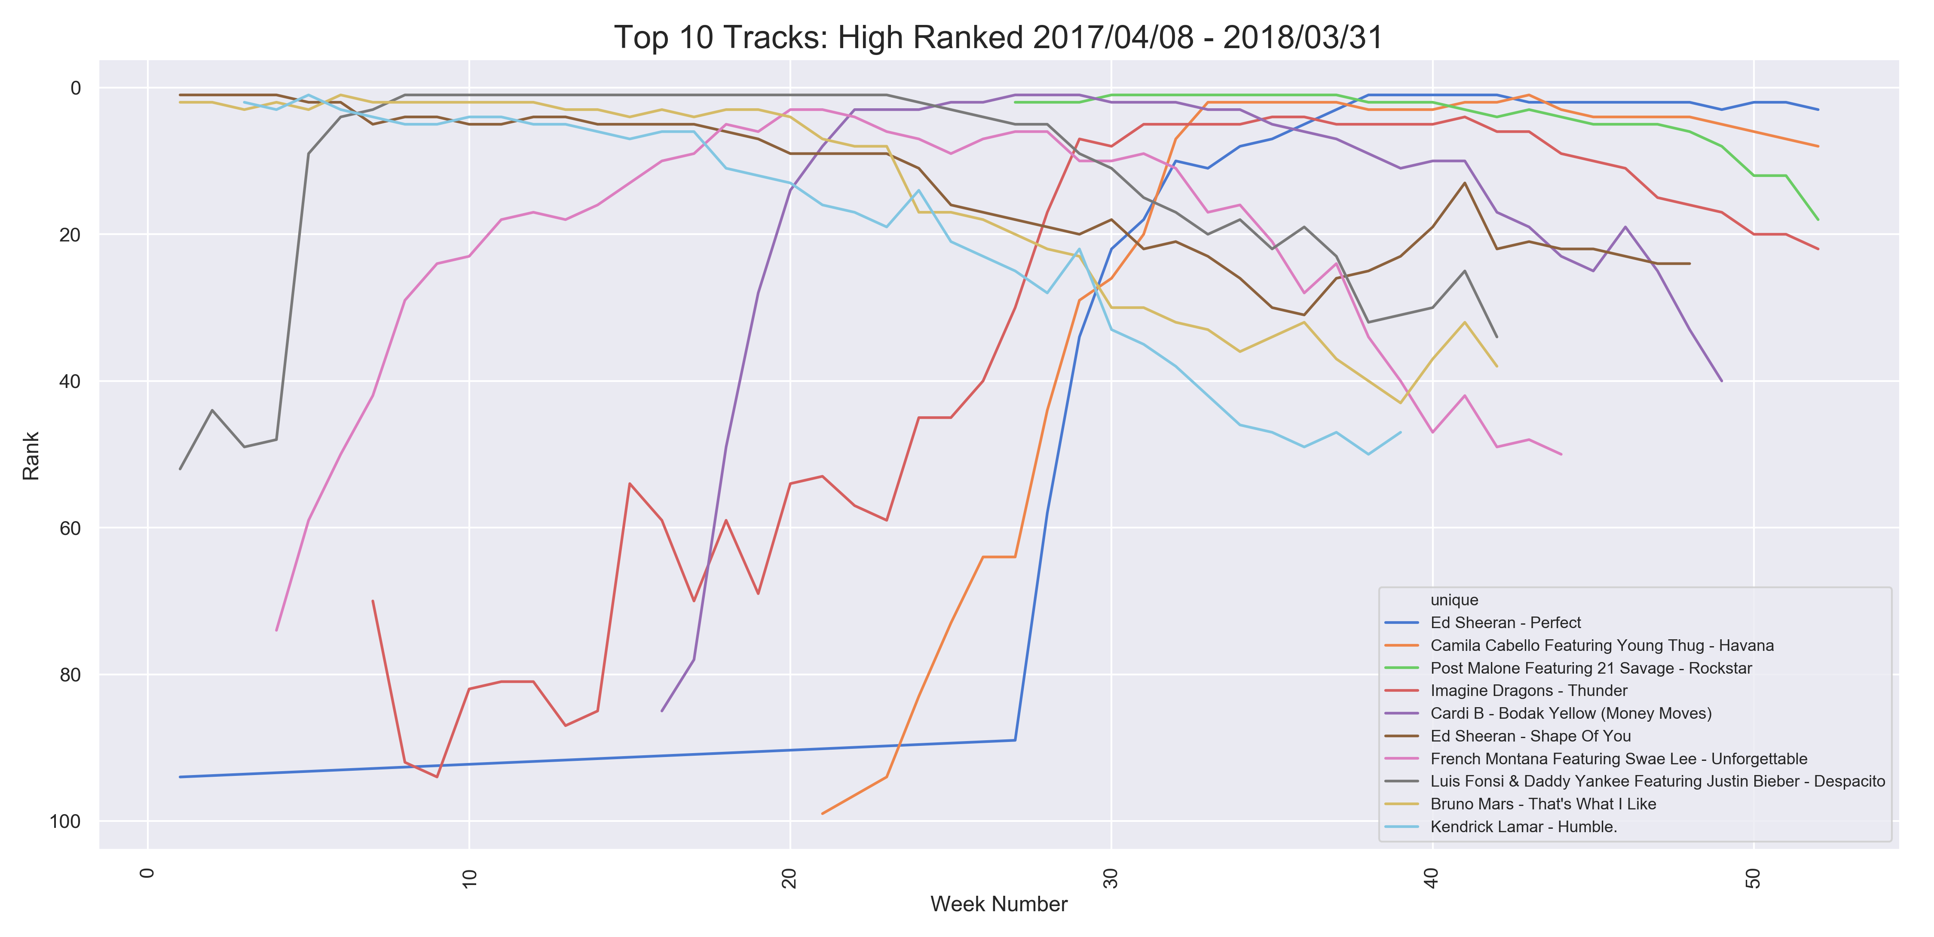
April 8, 2017 - March 31, 2018
Artists with Rank <= 10: in DESC order

Slide 6
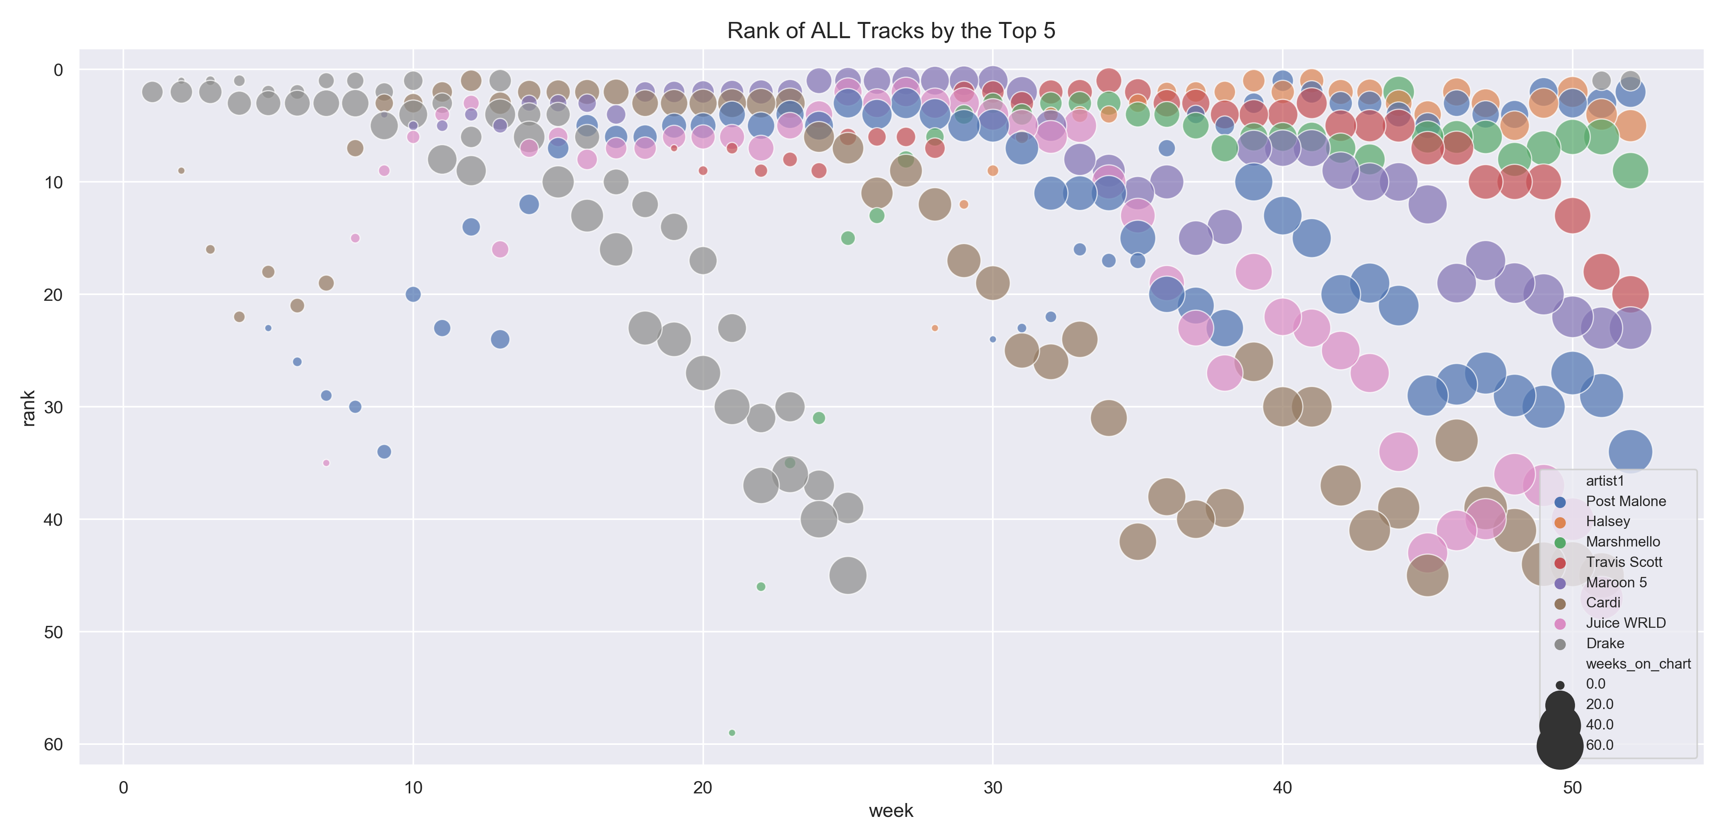
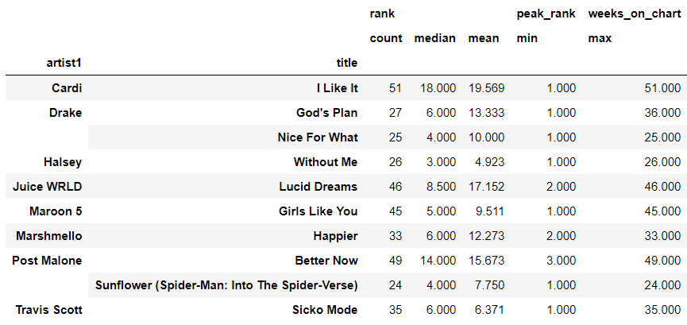


Slide 7

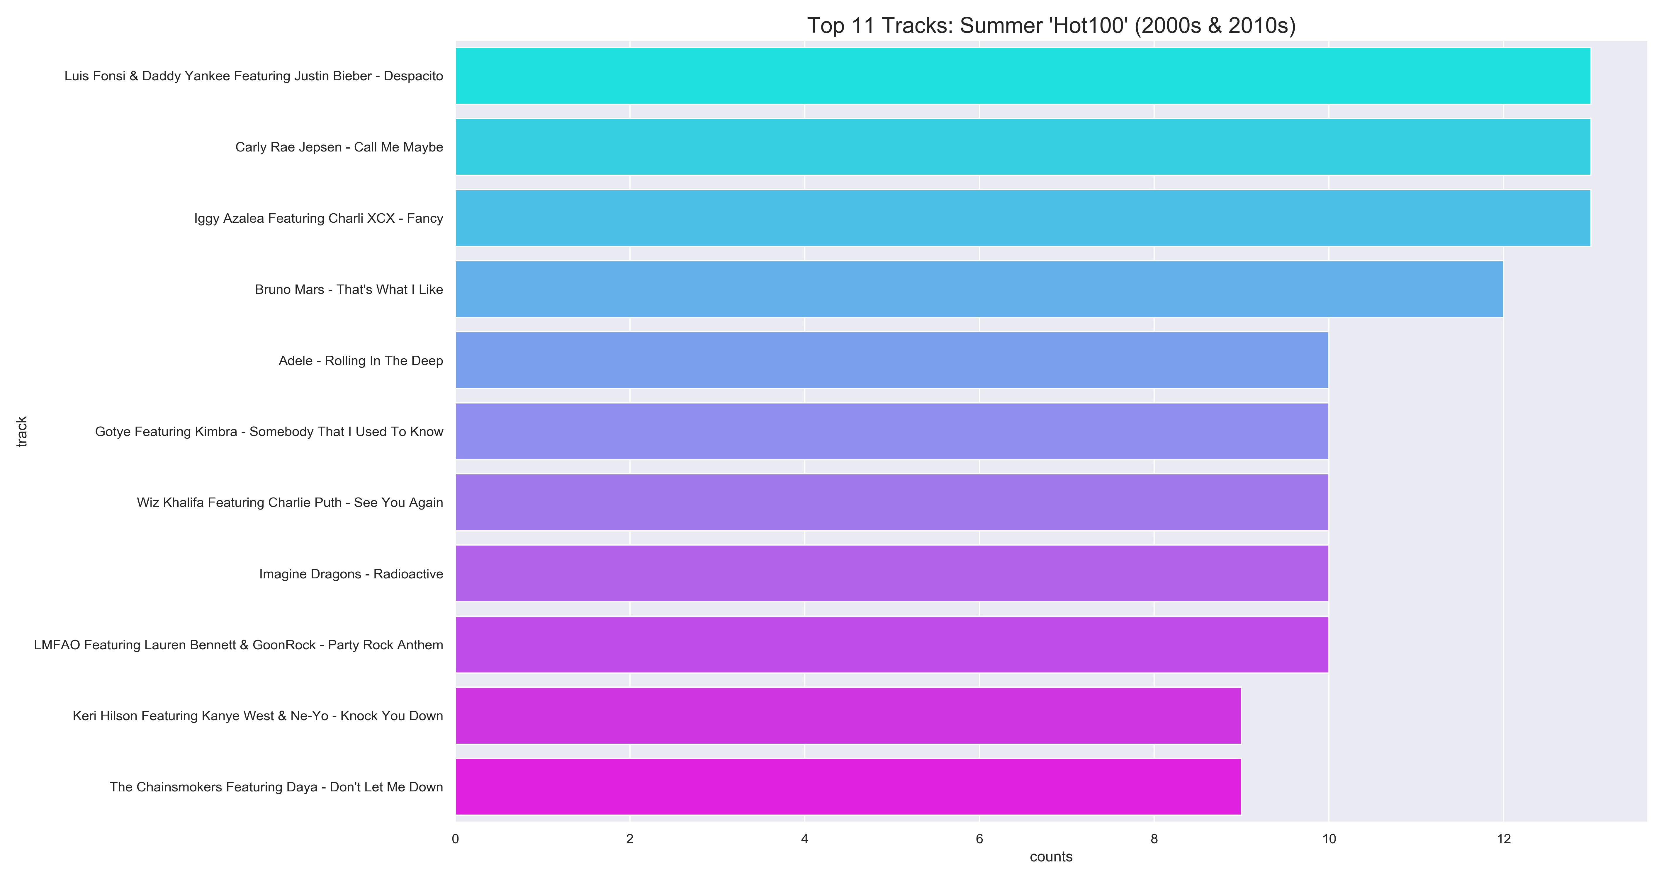
What are some noticeable Summer Songs for past 19 years?
Weeks on chart >= 12. Rank <= 5, Date >= 2000-01-01, Months in [6.7.8]

Slide 8
Key
the estimated overall key of the track;
e.g. 0 = C, 1 = C♯/D♭, 2 = D...etc
Mode
the modality (major or minor) of a track;
Major = 1, Minor = 0
Danceability
how suitable a track is for dancing; (0.0 - 1.0)
Energy
perceptual measure of intensity and activity; (0.0 -1.0)
Valence
musical positiveness conveyed by a track; (0.0 -1.0)
Tempo
the overall estimated tempo of a track in beats per minute (BPM)
Spotify Web API
Based on simple REST principles, the Spotify Web API endpoints return JSON metadata. API provides audio features for every songs in the library

Slide 9

Exploring/Understanding
the Musical Features:
1990s to 2010s in U.S.

Slide 10

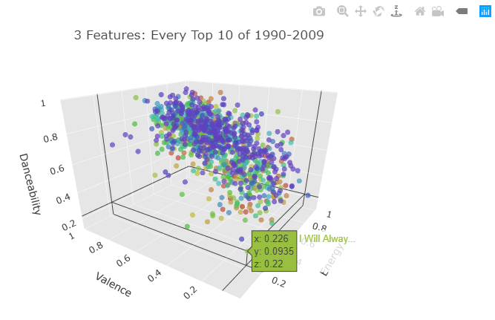
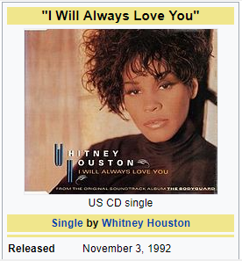
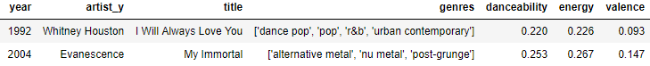
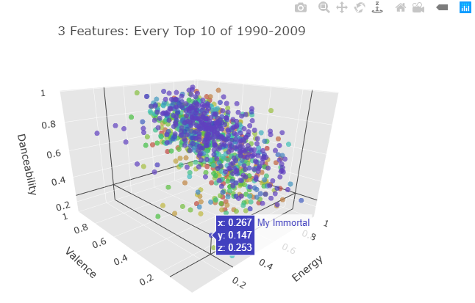
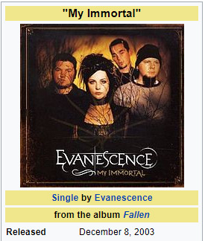
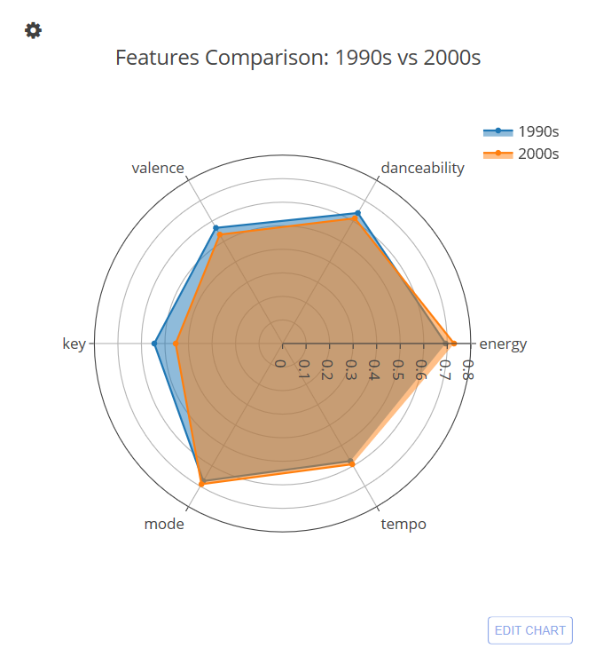

Slide 11
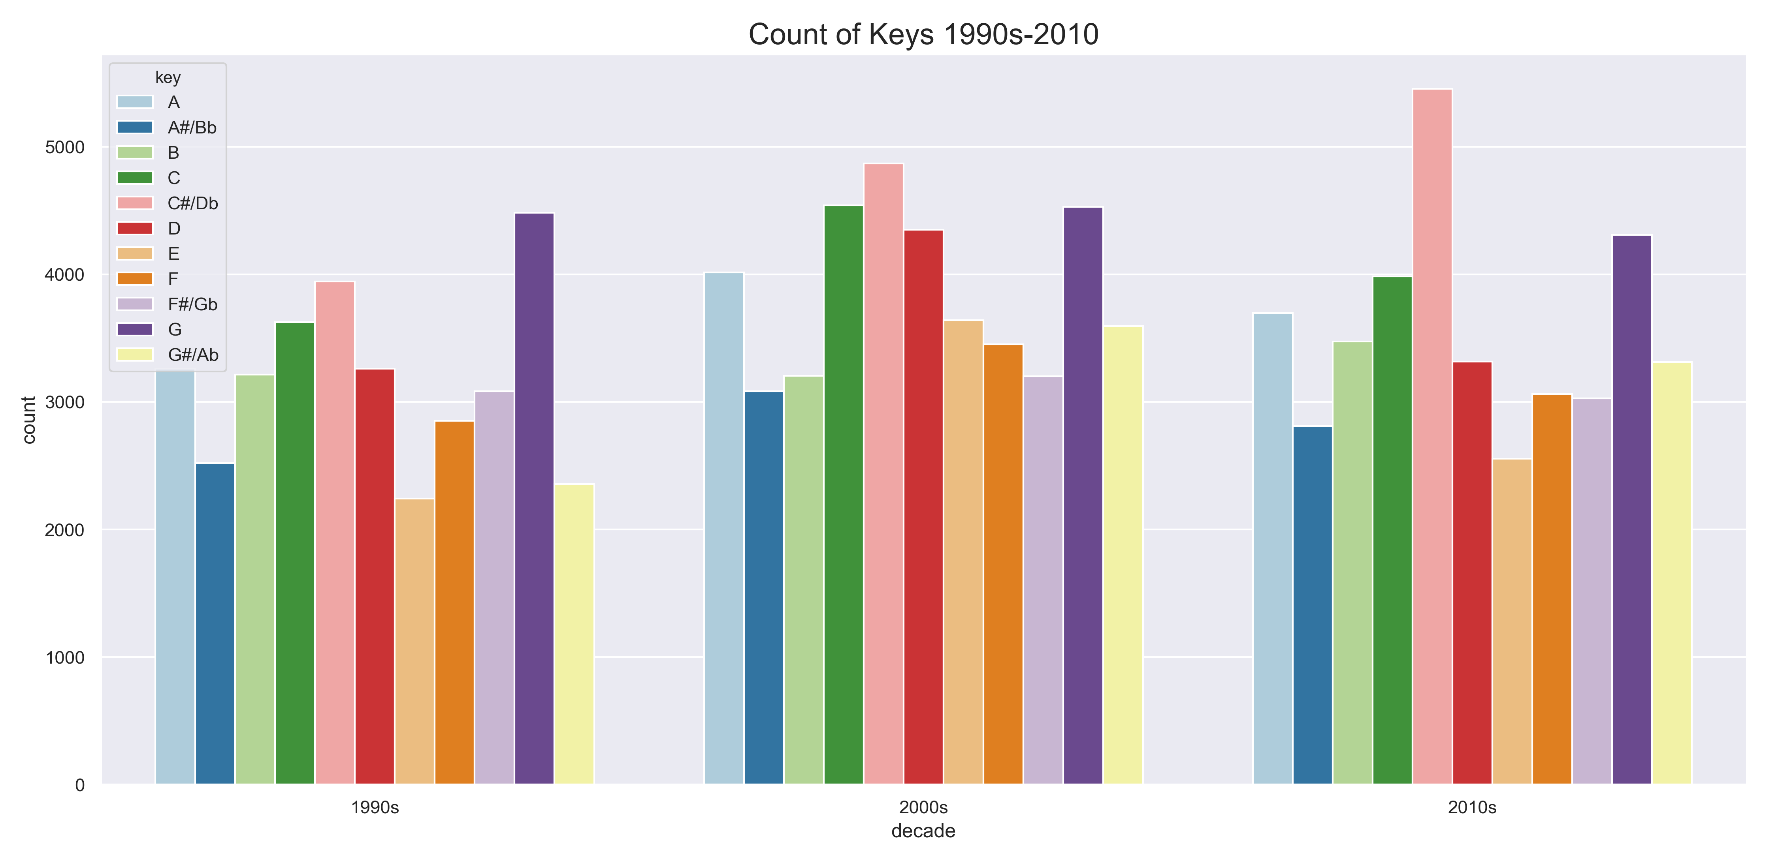
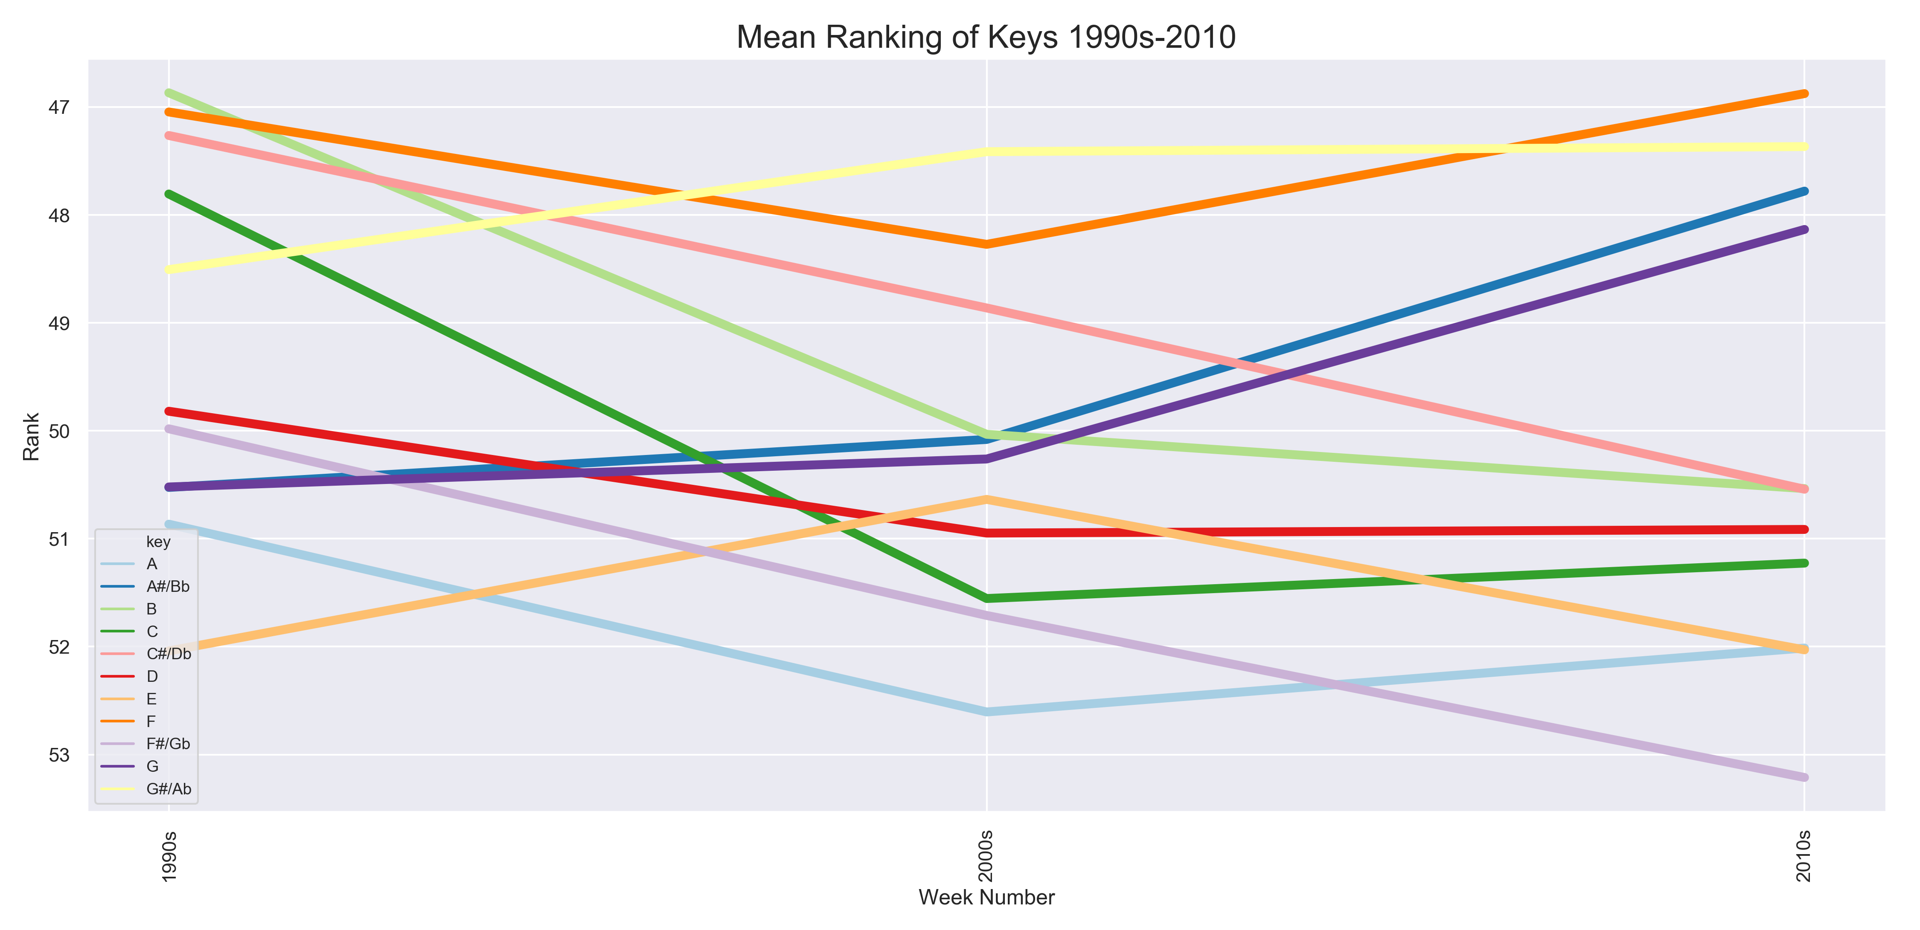

Slide 12
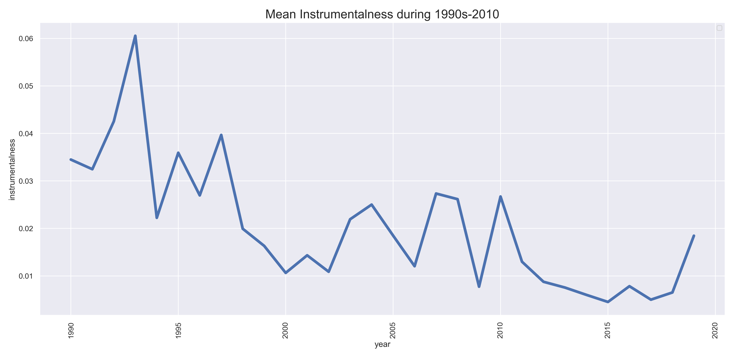
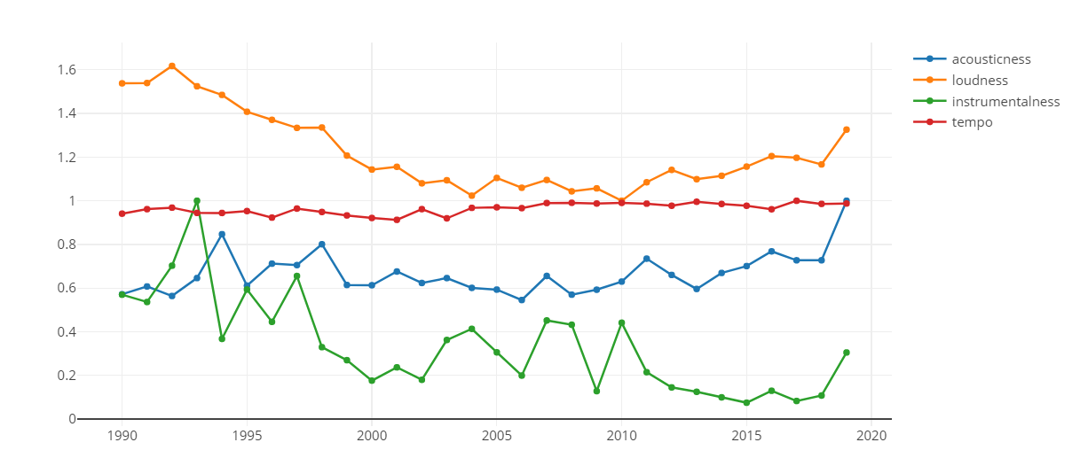

Slide 13
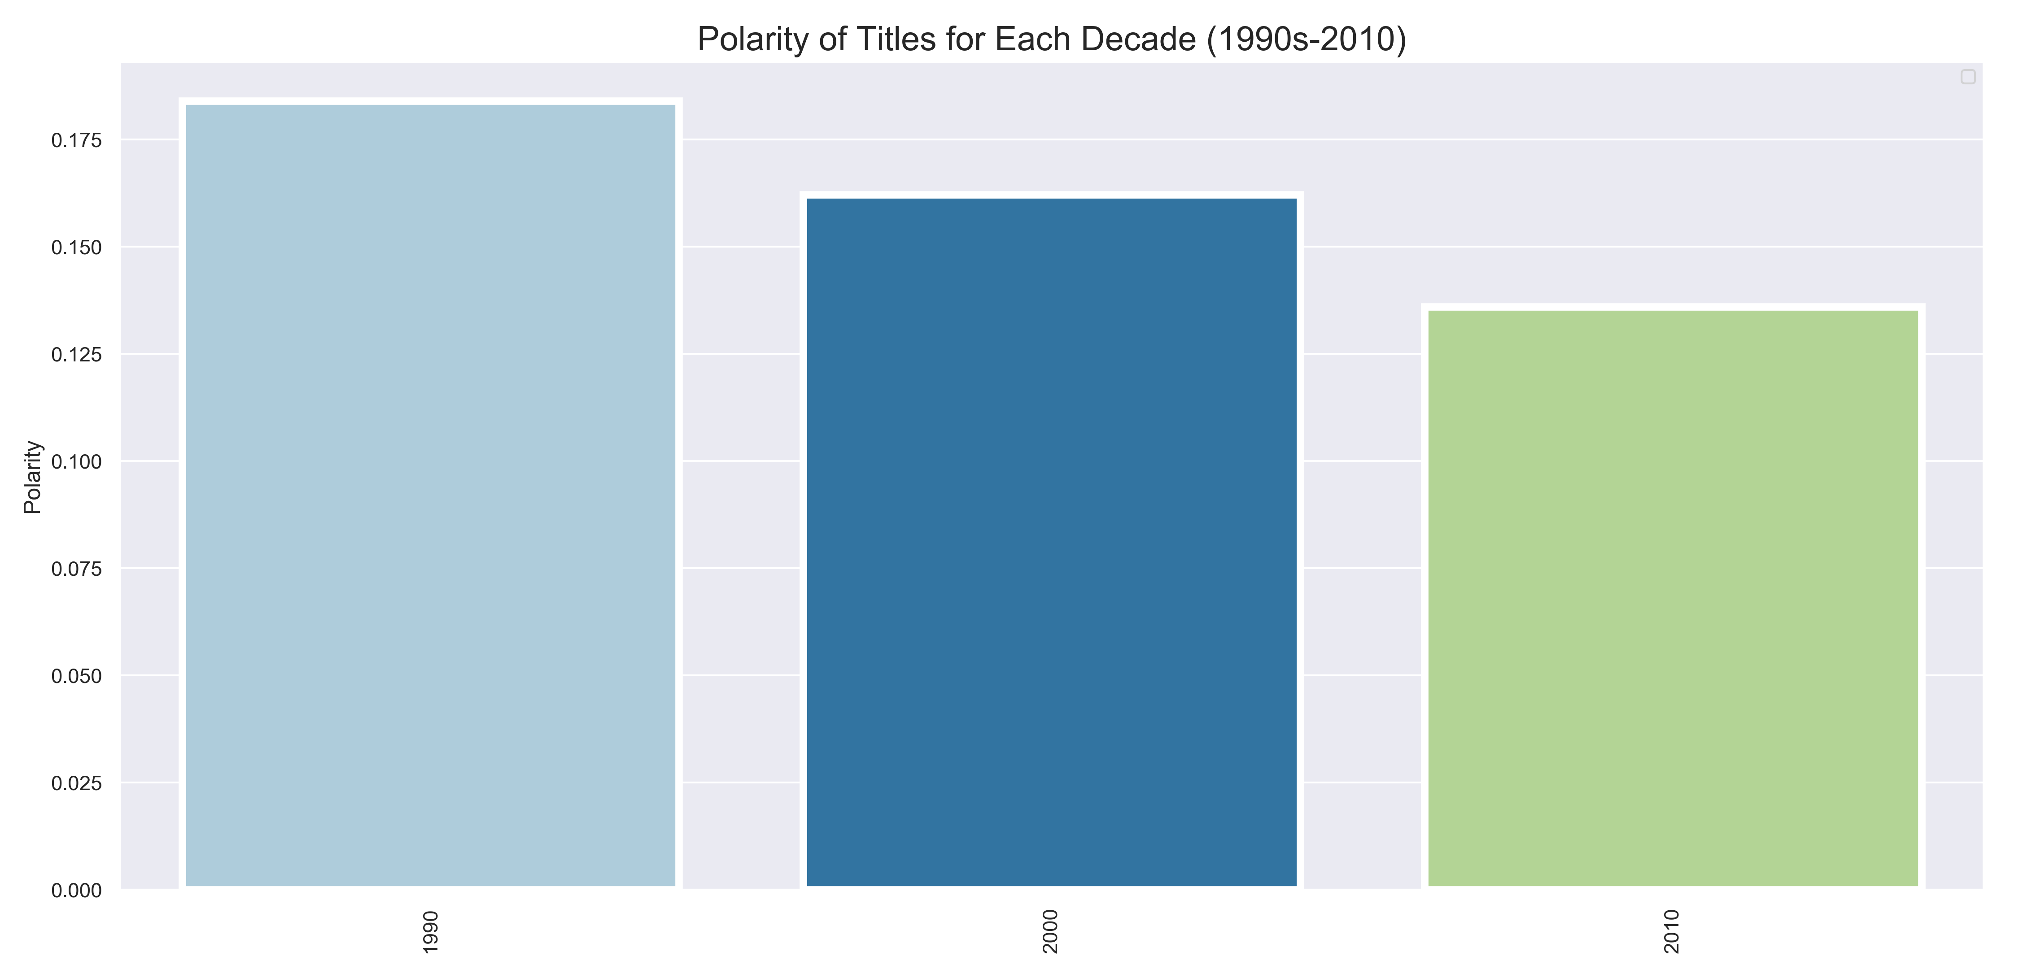

Slide 14
Joyful & Bright Song on
Billboard Hot Chart:
By The Beatles

Slide 15
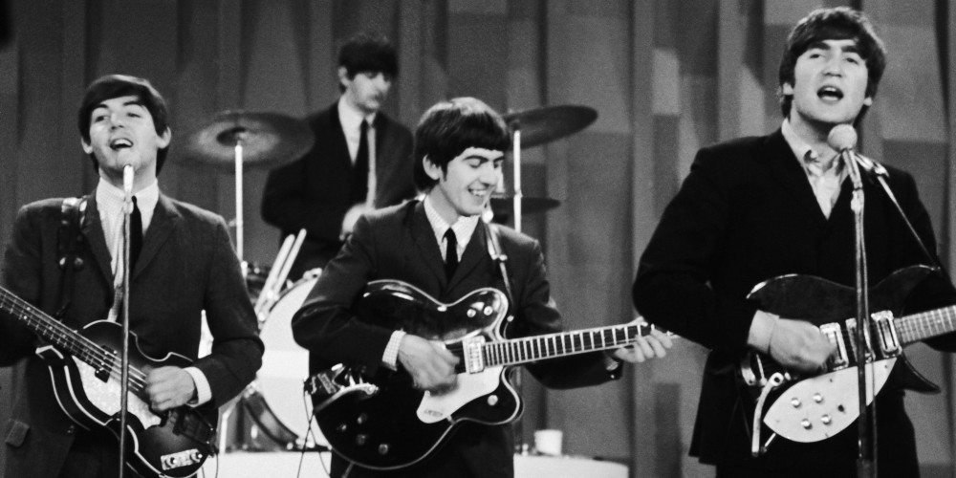

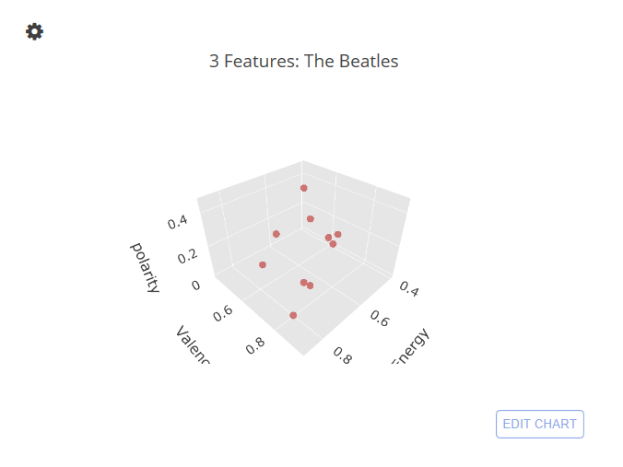

Slide 16

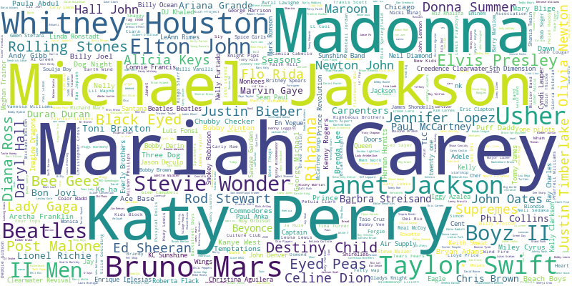
QUESTION

Slide 17
https://plot.ly/~choym92/20/_3-features-the-beatles/

